Slide 1
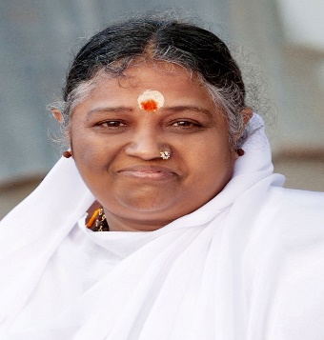



Amrita School of Spiritual & Cultural Studies
The Role of Meditation in Improving Interpersonal Communication and Relationship Quality
Dr. Shobhana Madhavan
Associate Professor
Amrita School of Business Coimbatore

Slide 2




Professional Background
BE (Delhi College of Engineering, Delhi University)
PGDM (MBA), IIM Ahmedabad
MPS International Development (Cornell University, New York)
PhD Deakin University, Australia
Worked in rural development and forest conservation projects in India, Madagascar, Vietnam, and Cambodia
Faculty at Amrita School of Business, Coimbatore, since 2004

Slide 3
Outline of Presentation and Learning Outcomes
Learning Outcome:
By the end of this session, students will be able to understand the positive role of meditation on
(a) Interpersonal communication
(b) Relationship quality
Why is Good Communication Important?
The Importance of Relationships
Barriers to Effective Communication
How Meditation can Help Overcome Barriers to Communication
Research on Meditation and Communication in Varied Relationship Contexts
Tips to Increase Mindfulness in Communication

Slide 4
Why is Good Communication Important?
Helps in Creating Harmonious Relationships
Communication is the Foundation of the Workplace
Will help you get a good job ☺
Dictionary Definitions
Communicate (English):
The process of giving information or of making emotions or ideas known to someone ; https://www.oxfordlearnersdictionaries.com/definition/english/communicate
Communicare (Latin)
To share; to make common; To impart https://www.wordsense.eu/communicare/

Slide 5
Human Beings Require Social Connectedness to Flourish
Social Connections are critical to a human being’s emotional and physical well-being
Love heals. Love helps us flourish.
Social exclusion and loneliness leads to depression and other health problems

Slide 6
Overcoming Communication Barriers with Meditation
Meditation helps relieve stress and anxiety (Brown, Ryan & Creswell, 2007)
Meditation helps develop active listening skills – listening with attention and caring
Meditation increases self-awareness
Mindfulness meditation promotes openness and a non-judgmental attitude (Kabat-Zinn, 1994)
Being Emotionally Disturbed
Being Unable to Listen
Unconscious Patterns of Thinking/ Vasanas
Being Judgmental / Feeling Judged
Notes:
Notes: Carl Rogers the American psychotherapist was a pioneer in promoting active non-judgmental listening as a skill for counsellors

Slide 7
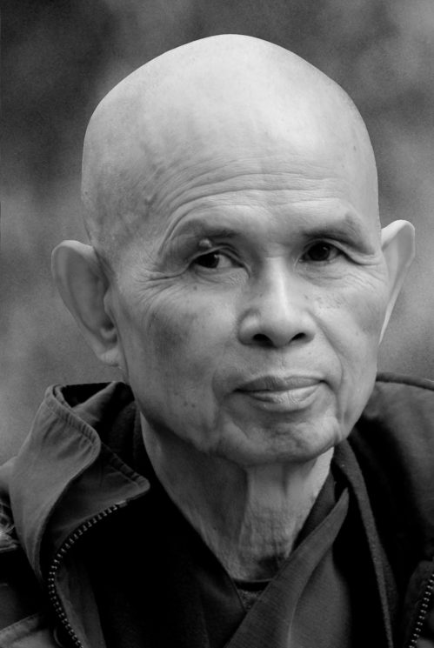
Communication and Meditation Tip # 1 Overcome Anger:When you are emotionally disturbed next time…
Bring your attention to the breath.
Breathe in and out consciously before you speak.
Breathing in, I calm my body.
Breathing out, I smile -
Thich Nhat Hanh
https://plumvillage.org/thich-nhat-hanh/press-photos/
Notes:
proactive to gauge business opportunities

Slide 8
Common Relationship Contexts
Parent-Child
At School and University
Other Close Relationships
Workplace

Slide 9
Parent-Child Communication Improves with Mindfulness/Meditation
Encourage your parents to meditate ☺
Mindfulness practices by parents can improve mother-adolescent communication (Lippold et al. 2015)
Negative reactions to disclosure
Adolescent feelings of parental
over-control
Affective quality of the interaction

Slide 10
Improve the Quality of Friendships at University with Meditation ☺
Meditation/ Mindfulness help us to become more self-aware and conscious of our thoughts and emotions.
Friendship quality improves when friends are self-aware, accepting, non-reactive, and have a high degree of empathy (Pratscher et al. 2018) .

Slide 11
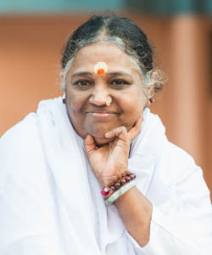
Communication and Meditation Tip # 2: Improve Relationships: Respond rather than React
When we react there is no gap between thought and words, or between words and action. Conflicts and misunderstandings may arise.
We should try and respond. We can do this by expanding the gap between our thoughts and words, and words and actions.
Meditation can help us to cultivate awareness and respond rather than react.

Slide 12
Improve the Quality of Other Close Relationships with Mindful Communication and Meditation
Meditate and Enjoy Togetherness in Harmony☺
Mindfulness improves quality of communication leading to increased relationship satisfaction (Gambrel & Keeling, 2010; Whitney & Chang, 2022)

Slide 13
Meditation Has A Positive Impact On Workplace Relationships And Leadership
Increases team cooperation (Yu & Zellmer-Bruhn 2018)
Mindfulness training improves leader’s behaviour toward employees by making them more attentive and open (Johnson et al. 2019)
Meditation has been found to improve employee communication skills (Good et al. 2015; Pradhan & Ajithkumar 2018)

Slide 14
Caveat: Meditation is not a Magic Pill that Improves Interpersonal Communication or Relationships
We need the lakshya or goal to improve our interpersonal communication skills and our relationships.
We need persistence and patience, communication skills will not improve overnight ☺
In short, Intention and Attitude are Important

Slide 15
सत्यं वद, प्रियं वद
Communication and Meditation Tip # 3: Right Speech Meditation
Let your speech be truthful, pleasant and useful.
Right timing and your intention is Important
Take a Deep Breath. Be Aware of the Inhalation and Exhalation.
Ask yourself “Is what I am saying truthful, pleasant, and useful? Is the timing right? What is my intention? Is it to help or to just speak or to show how clever I am ?
.

Slide 16
Communication and Meditation Tip # 4: Telephone Meditation
Breathing in, you say: ‘Words can travel thousands of miles;’
Breathing out: ‘They are supposed to build up more understanding and mutual acceptance;’
Breathing in, ‘I vow that my words will be like gems;’
Breathing out, ‘I vow that my words will be fresh like flowers.’
Thich Nhat Hanh
Source: https://buddhismnow.com/2014/05/03/telephone-meditation-by-thich-nhat-hanh/

Slide 17
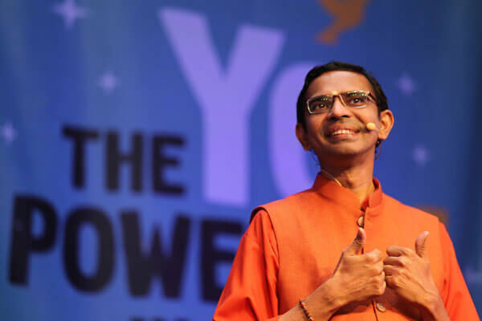
Mastery of Mind Gives You Inner Power
“In fact, power is a state that helps you to be happy, peaceful, and strong however challenging the external situation may be. It is something that gives you the capacity to have the right thought, to say the right word, and to do the right thing at the right time. That is power,” he said, adding that it is an experience that comes through mastery of the mind” https://www.amritapuri.org/81769/22youth.aum
- Swami Shubamritananda Puri

Slide 18
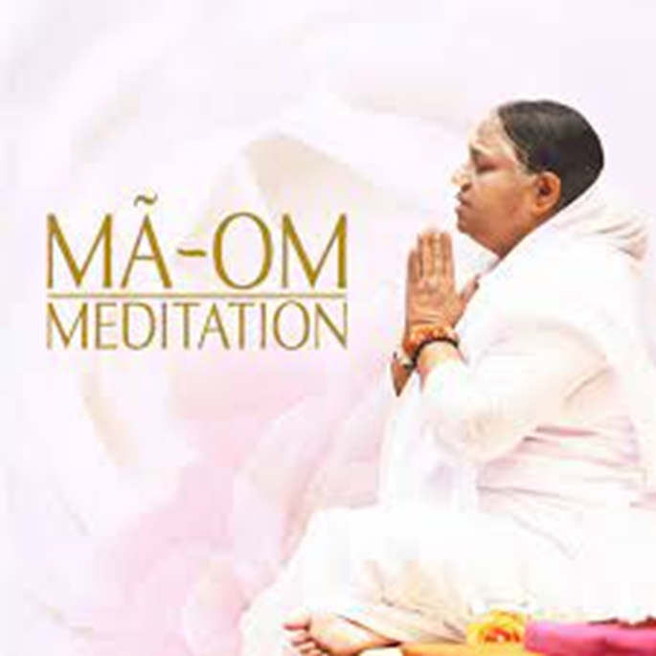
Mastery Over Mind
लोकाः समस्ताः सुखिनो भवंतु.

Slide 19
References …1
Brown, K. W., Ryan, R. M., & Creswell, J. D. (2007). Mindfulness: Theoretical foundations and evidence for its salutary effects. Psychological inquiry, 18(4), 211-237.
Gambrel, L. E., & Keeling, M. L. (2010). Relational aspects of mindfulness: Implications for the practice of marriage and family therapy. Contemporary Family Therapy, 32(4), 412-426.
Good, D. J., Lyddy, C. J., Glomb, T. M., Bono, J. E., Brown, K. W., Duffy, M. K., ... & Lazar, S. W. (2016). Contemplating mindfulness at work: An integrative review. Journal of management, 42(1), 114-142
Johnson, Karen R., Sunyoung Park, and Sanghamitra Chaudhuri. "Mindfulness training in the workplace: Exploring its scope and outcomes." European Journal of Training and Development (2020).
Kabat-Zinn, J. (1994). Wherever you go. There you are: mindfulness meditation in in everyday life. Hachette: New York

Slide 20
References … 2
Lippold, M. A., Duncan, L. G., Coatsworth, J. D., Nix, R. L., & Greenberg, M. T. (2015). Understanding how mindful parenting may be linked to mother–adolescent communication. Journal of youth and adolescence, 44(9), 1663-1673.
Pradhan, S., & Ajithkumar, V. V. (2019, February). Effectiveness of Vipassana Meditation on Communication Skills of Employees. In SIMSARC 2018: Proceedings of the 9th Annual International Conference on 4C’s-Communication, Commerce, Connectivity, Culture, SIMSARC 2018, 17-19 December 2018, Pune, MH, India (p. 158). European Alliance for Innovation.
Pratscher, S. D., Rose, A. J., Markovitz, L., & Bettencourt, A. (2018). Interpersonal mindfulness: Investigating mindfulness in interpersonal interactions, co-rumination, and friendship quality. Mindfulness, 9(4), 1206-1215.
Whitney, J., & Chang, D. F. (2020). Inner tradition made visible: the interpersonal benefits and effects of meditation practice on close relationships. Current Psychology, 1-11.
Yu, L., & Zellmer-Bruhn, M. (2018). Introducing team mindfulness and considering its safeguard role against conflict transformation and social undermining. Academy of Management Journal, 61(1), 324-347.

